Slide 1





Heart Attack Risk Prediction Using Machine Learning
Team Members :
Mentor : Mr . Saomya Chaudhury
Peddimudi HymaVathi, duraiemma@gmail.com
Palla Mounika, pallamounika0@gmail.com
Gangumalla Nikhila, nikhilagangumalla@gmail.com
Vabhirineedi Sai Saranya, saranyavabhirineedi@gmail.com
Disclaimer: The content is curated for educational purposes only.
Notes:
Slides: Prepare a short slide deck (10-12 slides) summarizing the project objectives, methodology, and key results.

Slide 2
Heart Attack Risk Prediction
OUTLINE
Abstract of the Project
Problem Statement
Proposed Solution
System Architecture
Live Demo of the Project
Embedded Video of Project
Conclusion
Future Scope

Slide 3
Abstract : Heart Attack Risk Prediction Using Machine Learning Heart disease remains one of the leading causes of mortality worldwide, highlighting the importance of early prediction and prevention. This project, titled Heart Attack Risk Prediction, aims to develop a machine learning-based system to assess the likelihood of heart attacks in individuals based on clinical and lifestyle parameters. The primary objective of this project is to design an efficient and accurate predictive model to assist healthcare professionals in identifying high-risk individuals. The methodology includes preprocessing the dataset, feature selection, and training multiple machine learning algorithms, such as Logistic Regression, Random Forest, and Support Vector Machines, to analyze key factors like age, cholesterol levels, blood pressure, and smoking habits.
Heart Attack Risk Prediction

Slide 4
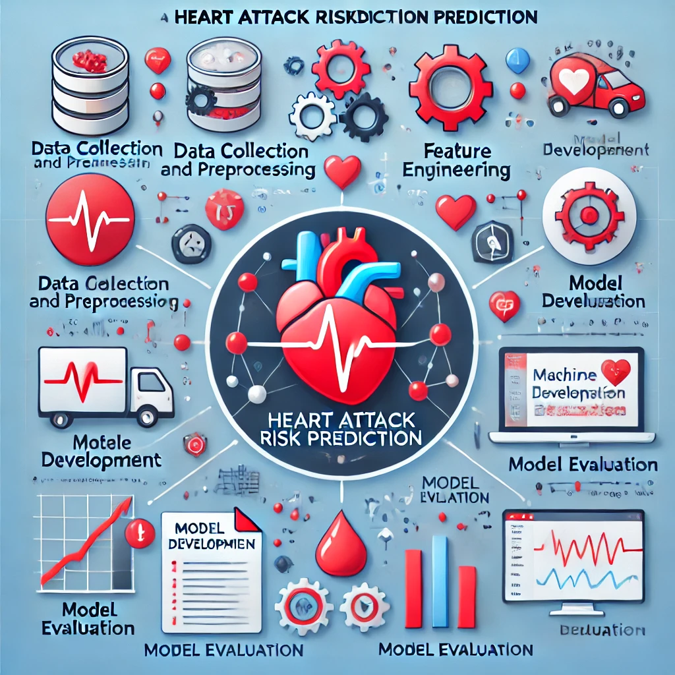
Problem Statement
Heart Attack Risk Prediction
Heart disease is a leading cause of death globally, accounting for millions of fatalities every year. Early detection of individuals at risk of heart attacks remains a significant challenge due to the complex interplay of various clinical and lifestyle factors. Traditional diagnostic methods often require extensive medical testing, making early intervention less accessible, especially in resource-constrained settings.
The inability to efficiently and accurately predict heart attack risks can result in delayed treatment, increased healthcare costs, and avoidable loss of life. There is a pressing need for a reliable, scalable, and automated solution that can assist healthcare professionals in identifying high-risk individuals early and accurately, enabling timely interventions and improving patient outcomes.

Slide 5

Proposed Solution
Heart Attack Risk Prediction
The solution involves developing a web application using Streamlit to predict heart attack risk. The system uses a preprocessed medical dataset with features like age, cholesterol, and blood pressure. Logistic Regression was employed to train the model due to its effectiveness in binary classification problems. The model was evaluated for accuracy and deployed to provide users with real-time predictions based on input clinical parameters.

Slide 6
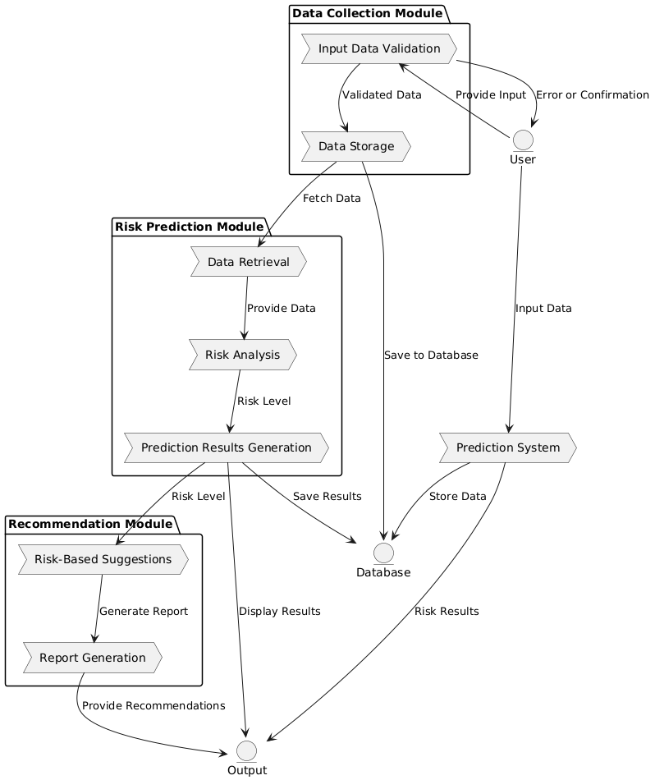
System Architecture
Heart Attack Risk Prediction
1. Data Collection Module (Level 0)
• Purpose: Collects and validates user input data (e.g., age, cholesterol).
• Processes: Validates inputs, stores data, and provides feedback to the user.
2. Risk Prediction Module (Level 1)
• Purpose: Analyzes data to predict heart attack risk.
• Processes: Retrieves data, performs risk analysis using a predictive algorithm, and generates results.
3. Recommendation Module (Level 2)
• Purpose: Offers actionable insights based on risk results.
• Processes: Provides personalized suggestions and generates a detailed report for the user.
give

Slide 7
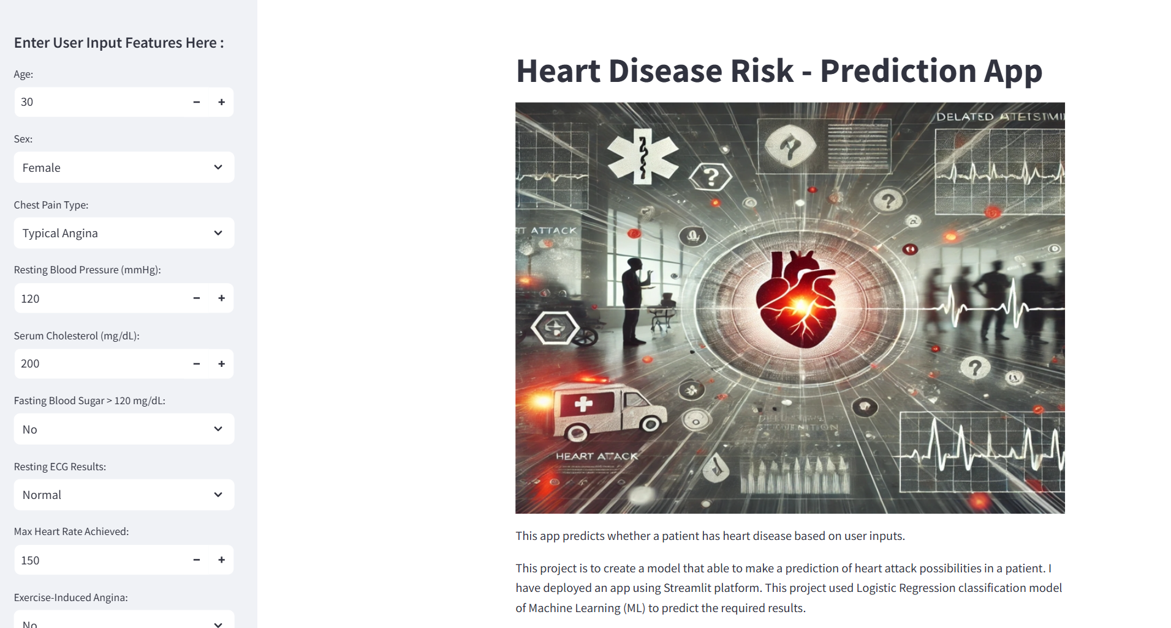
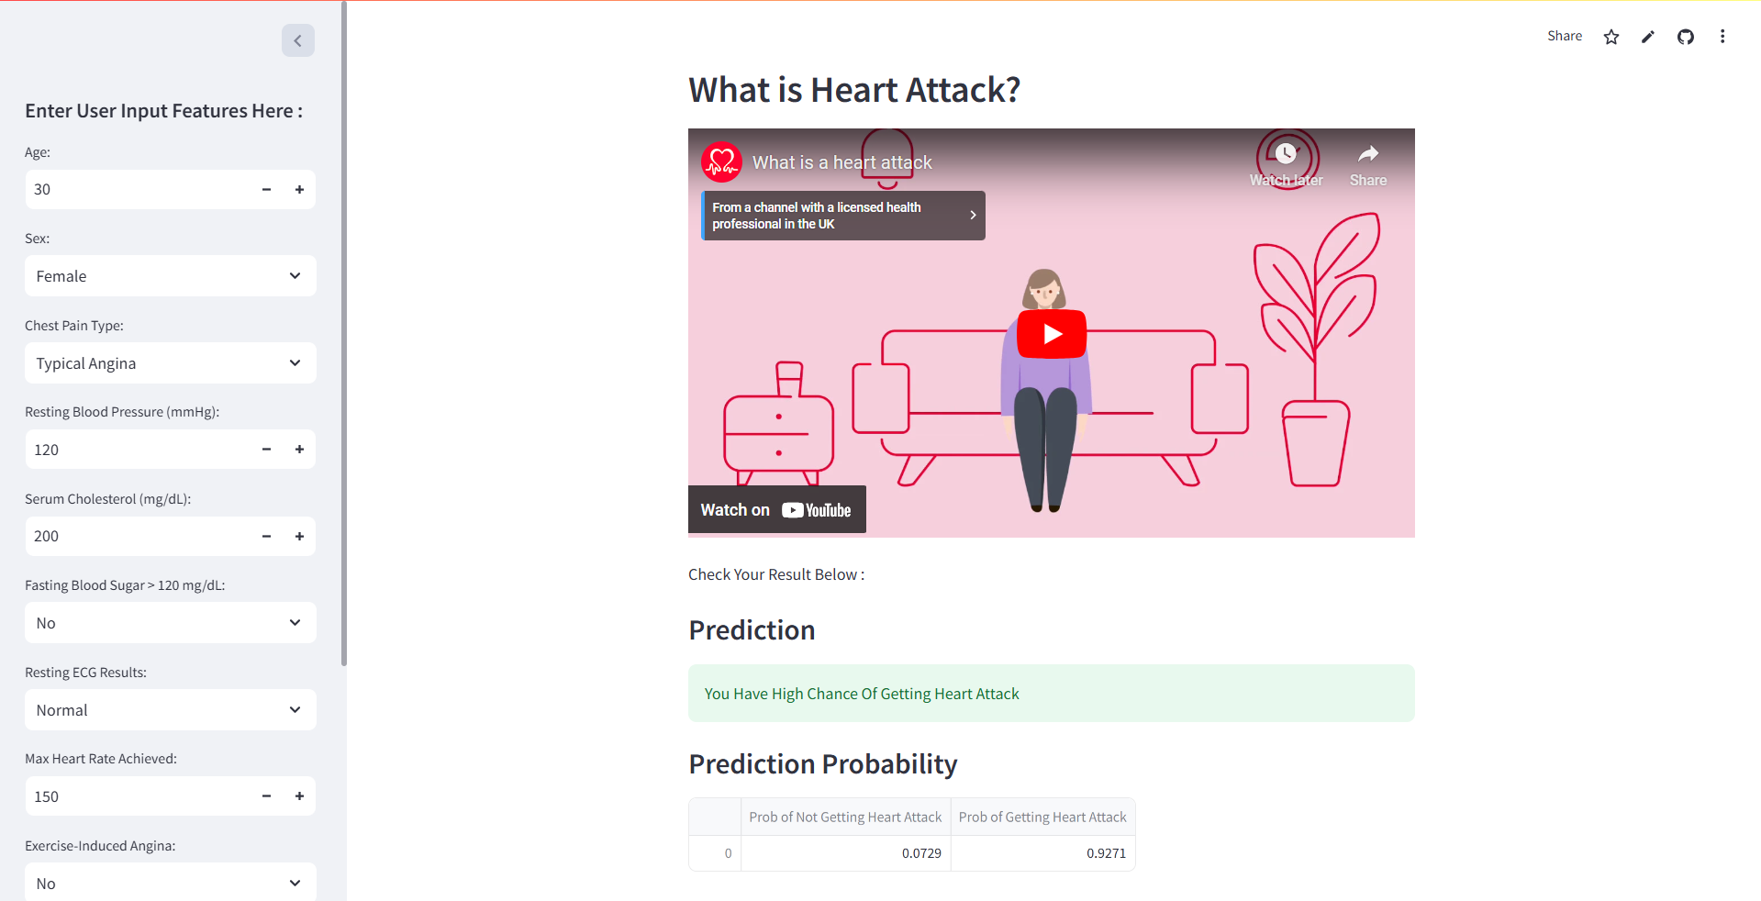
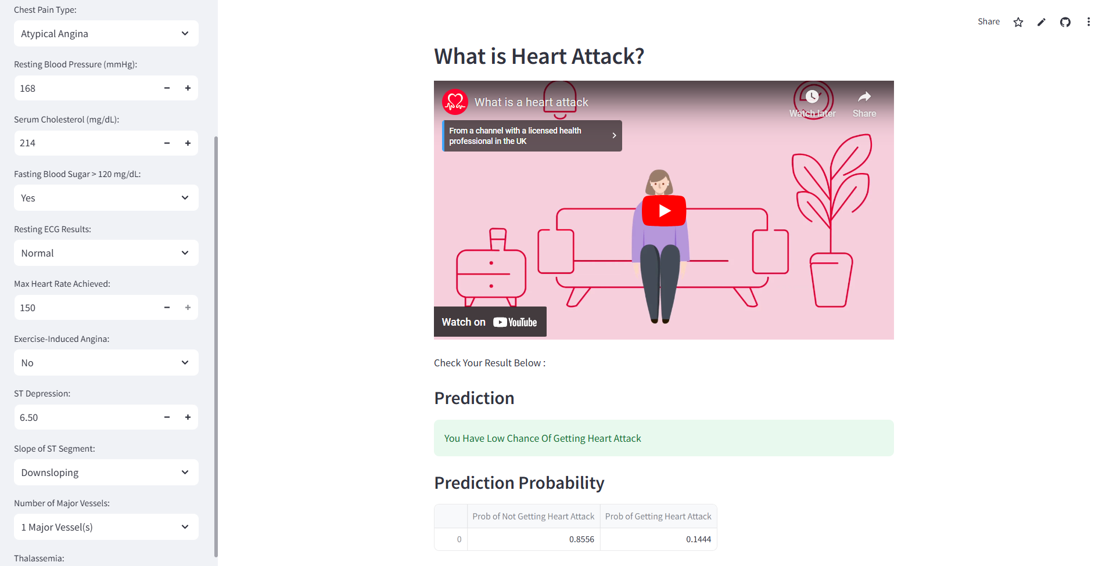
Live Demo of Project : Click Here
Heart Attack Risk Prediction

Slide 8

Heart Attack Risk Prediction
Video of Project Demo

Slide 9

Conclusion
Heart Attack Risk Prediction
The Heart Attack Risk Prediction project successfully integrates a machine learning model with a web interface for real-time predictions. By using Logistic Regression and employing data preprocessing techniques, the model accurately classifies the risk of heart attacks based on user inputs, such as age, cholesterol levels, and other clinical parameters.
Key Achievements:
Developed an intuitive interface using Streamlit for easy input collection.
Applied Logistic Regression to predict heart attack risk.
Deployed the model for real-time prediction on a live website.

Slide 10

Future Scope
Heart Attack Risk Prediction
The future scope of your Heart Attack Risk Prediction project includes:
Wearable Device Integration: Real-time health monitoring with smart devices.
Advanced ML Algorithms: Using deep learning and ensemble methods for better predictions.
Big Data & Cloud Computing: Scaling and integrating large datasets for more robust predictions.
Explainable AI: Making predictions transparent and understandable for users and doctors.
Personalized Recommendations: Providing tailored health advice and alerts.
Data Privacy & Security: Ensuring encrypted data handling and compliance with health regulations.
Health Network Integration: Connecting with EHR systems and collaborating with healthcare professionals.
Continuous Learning: Allowing the model to adapt and improve over time with new data.
These areas will enhance the project's capabilities and real-world applications.

Slide 11
Heart Attack Risk Prediction
Thank you!
Notes:
thank you very much for joining this PPT, keep learning.
11

